Slide 1
Microsoft for students
MSP Ukraine

Slide 2
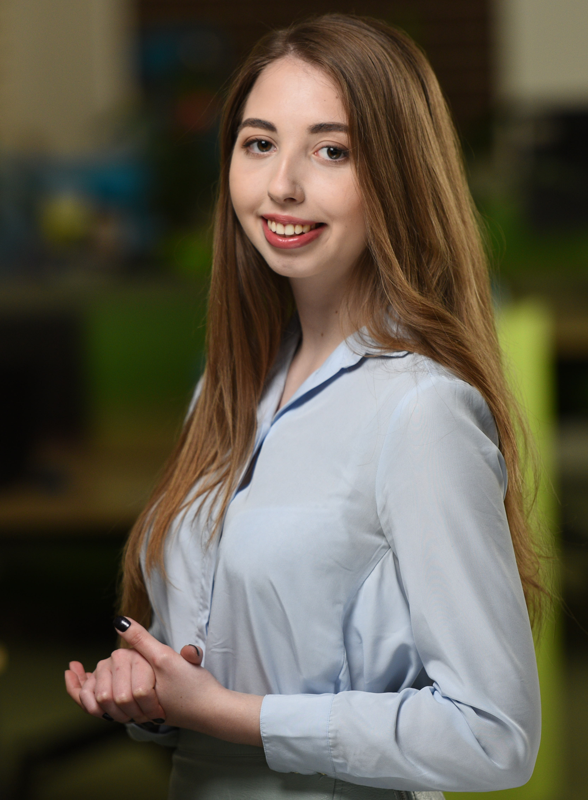
Nataliia Dranchuk
.NET developer, Smart Business
Microsoft Student Partner
Education:
National University of Kyiv Mohyla Academy,
Faculty of Informatics
Specialization: Software engineering

Slide 4
Imagine Cup 2019: Steps to success
Build your team
1-3 + mentor(optional)
Prepare business plan & presentation
Find your idea
Come and win it!
Create prototype
September,
2018
October,
2018
November, 2018 –
February, 2019
March, 2019
April, 2019

Slide 5
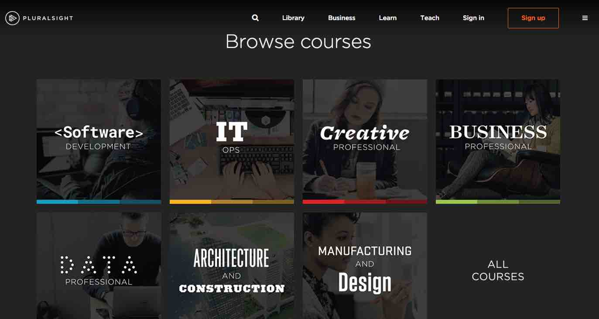
Pluralsight: Improve your skills
Get 3-month free trial with your Microsoft Account
https://www.visualstudio.com/dev-essentials/

Slide 6
Azure for students
https://azure.microsoft.com/en-us/free/students/

Slide 7
Azure services
Web apps
Virtual machines
Cognitive Services
Databases

Slide 8
Microsoft Student Partners
Worldwide community
Access to top conferences, experts and materials
Soft skills improvement

Slide 9
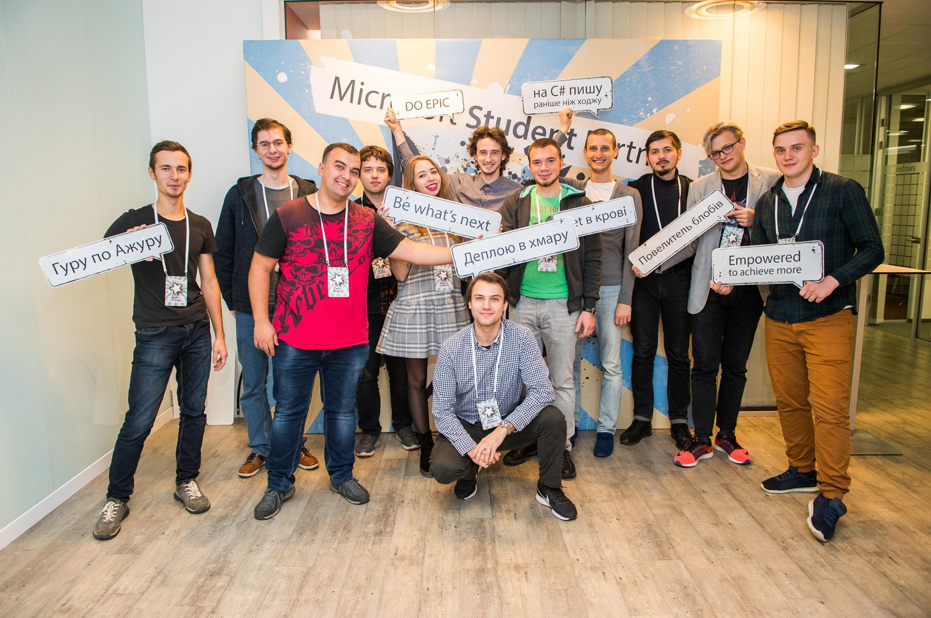
Microsoft Student Partners Ukraine

Slide 10
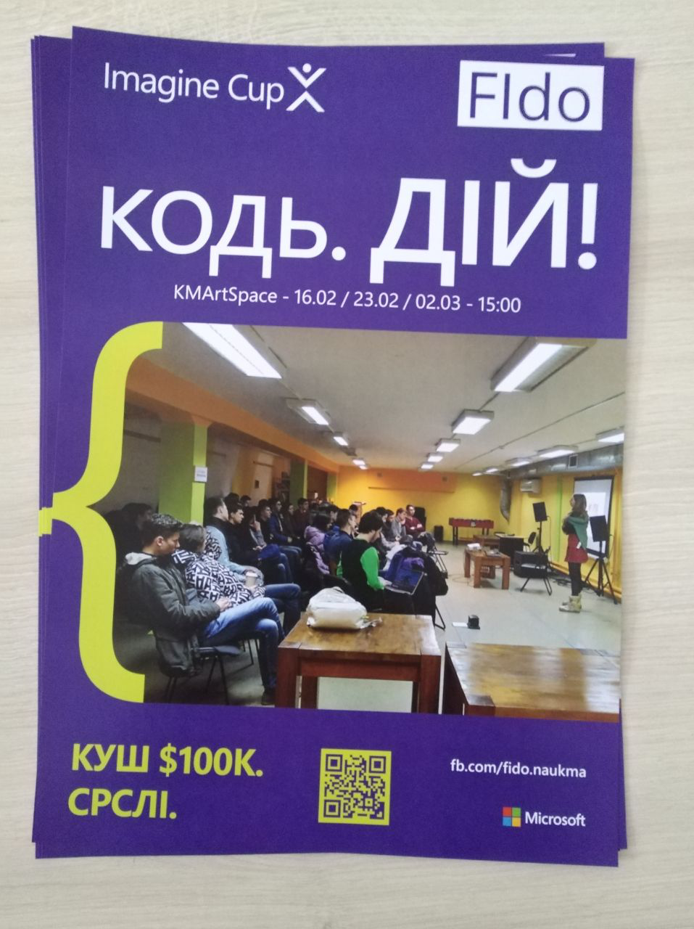
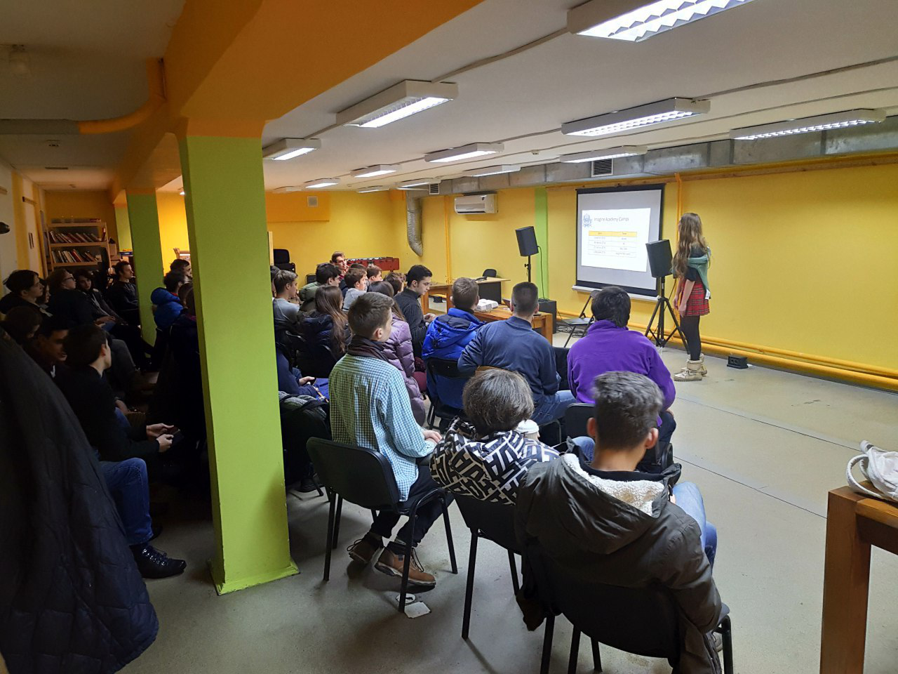
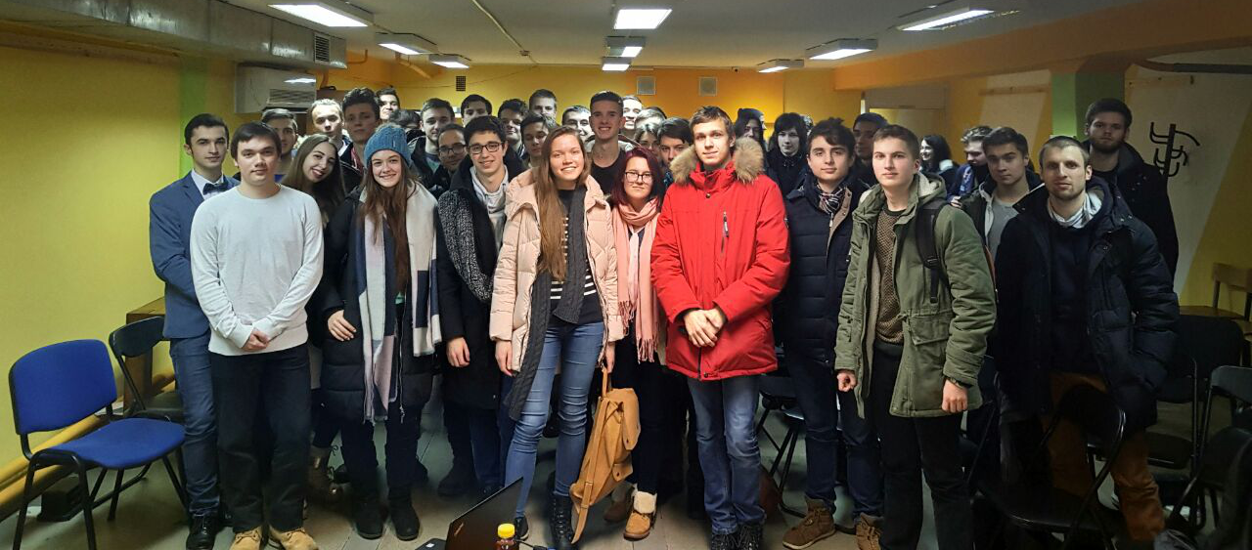
Bright university life

Slide 11
Soft skills
Inspire & be inspired
Public speaking
Being a leader

Slide 12
Join our community
Use your favorite Microsoft technologies
Be open-minded & build university community
Be active

Slide 13
Stay connected https://www.facebook.com/MSPInUkraine/ natalii.Dranchuk@studentpartner.com https://www.facebook.com/nataliya.dranchuk

Slide 14
Questions?

Slide 15
We love you!

